Slide 1
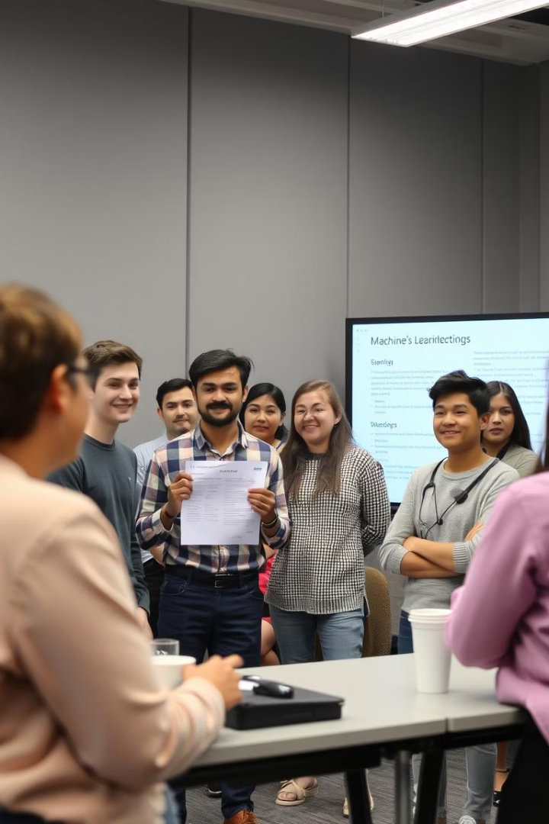
Teaching Computers to Recognize Cats and Dogs
G. Bharath

Slide 2
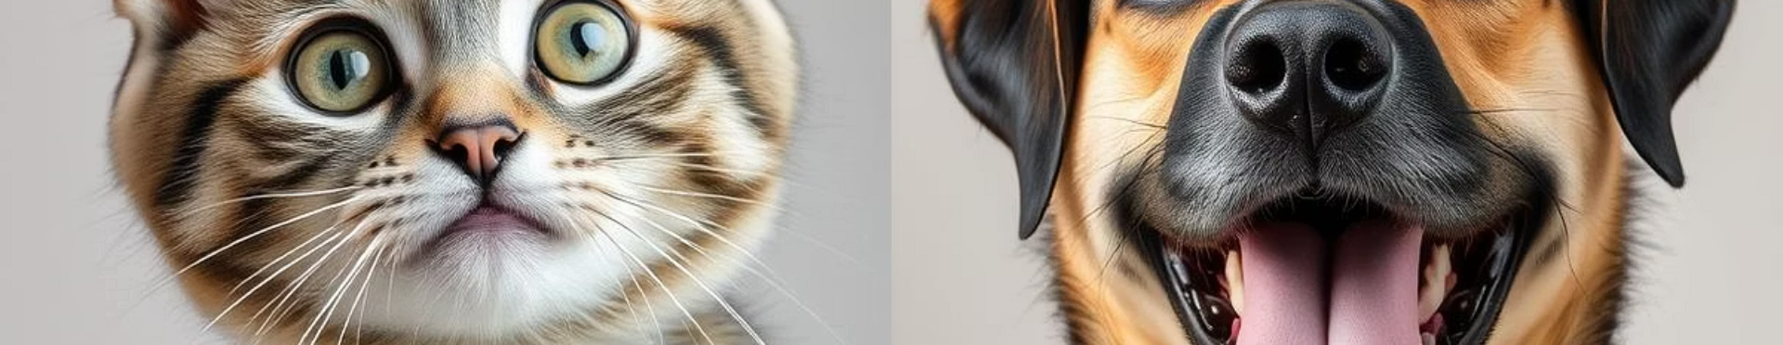
Project Process / Methodology
Step 1: Define the problem – image classification of cats and dogs
Step 2: Choose model – MobileNetV2 (pre-trained on ImageNet)
Step 3: Upload images using Google Colab
Step 4: Preprocess images using PIL, OpenCV, NumPy
Step 5: Classify and decode predictions
Tools Used: Python, TensorFlow, MobileNetV2, Google Colab

Slide 3
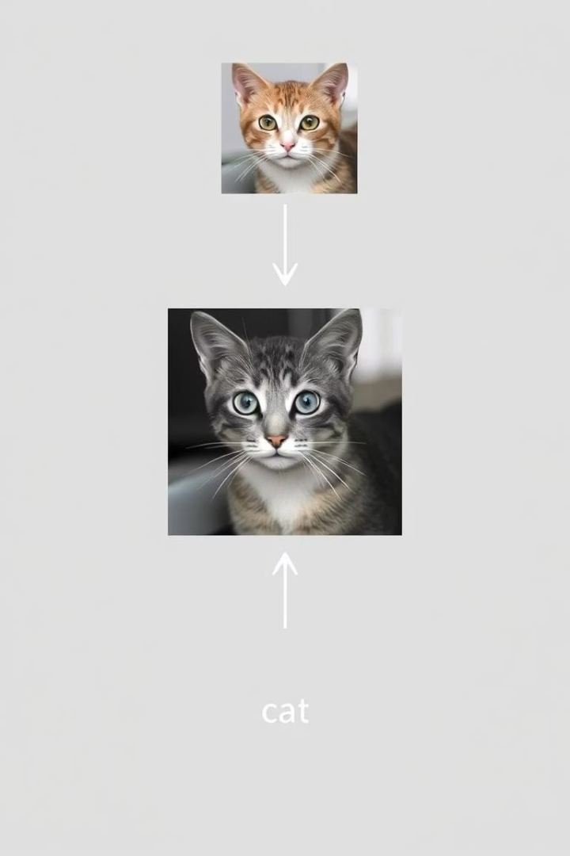
Features & Benefits
Features:
Real-time image classification
Uses deep learning model (MobileNetV2)
Works on JPG/PNG images
Benefits:
Demonstrates AI capabilities
Helps beginners learn transfer learning
Applications in pet care, surveillance, and animal welfare

Slide 4
USP of the Project
Uses a powerful yet lightweight pre-trained model
Simplified code that runs on Google Colab (no local setup needed)
User-friendly – only requires uploading an image
Highly accurate – based on ImageNet predictions
We also used image augmentation techniques like scaling, rotating, cropping, and flipping. These help improve model training and prevent overfitting.

Slide 5
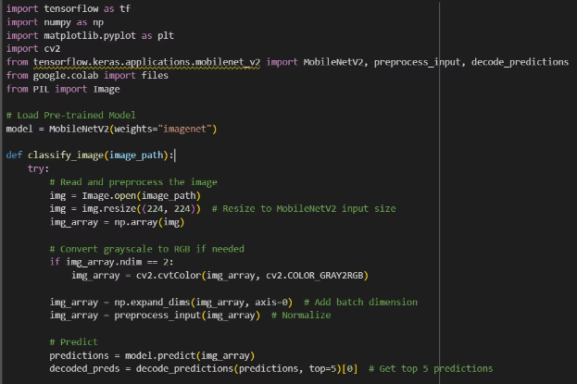
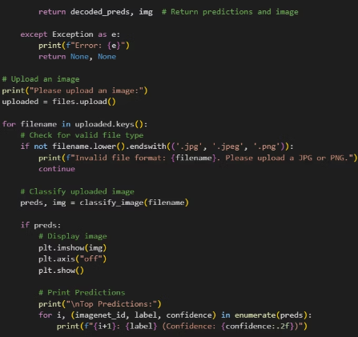
3D Model Demonstration
Model Visualization:

Slide 6
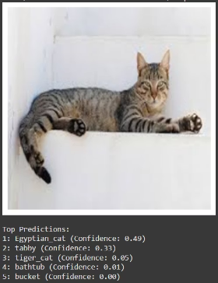
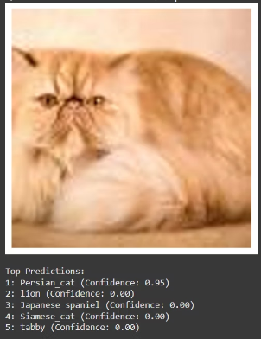
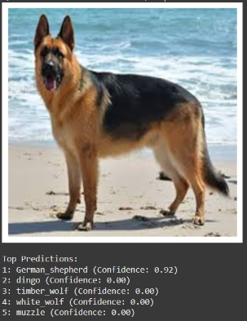
Prediction Output Example

Slide 7
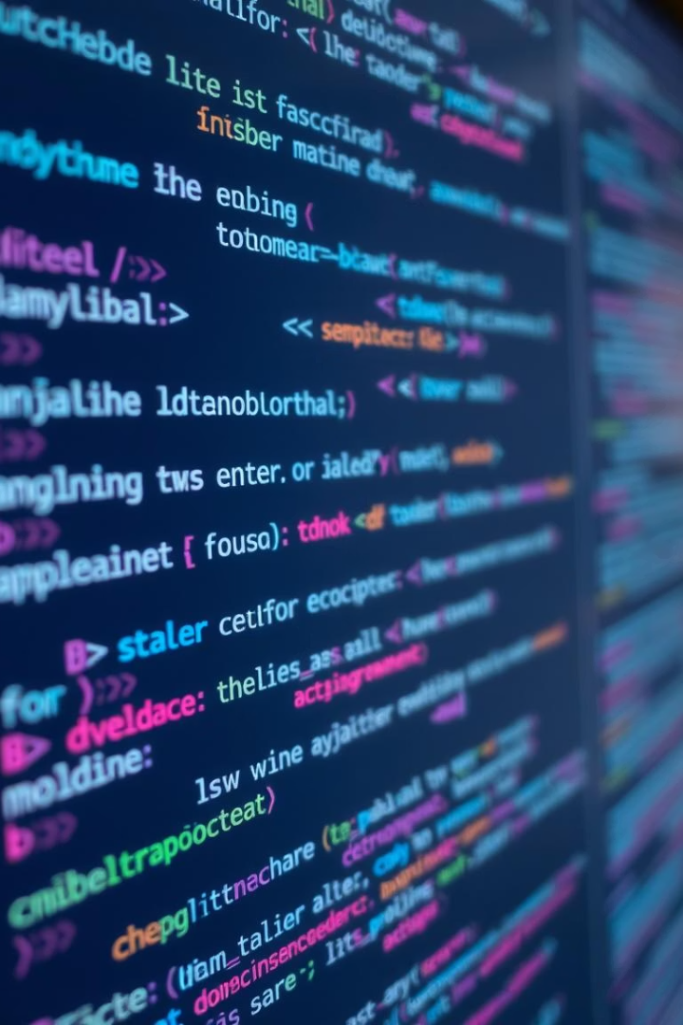

Summary
Project uses deep learning for image recognition
Implemented using MobileNetV2 in Google Colab
Handles real image inputs and predicts top 5 labels
Easy to use and understand
Team collaboration and technical learning achieved

